Slide 1



Real-Time 3D Semantic Mapping with Multimodal Data for Autonomous Robotic Navigation
Student: Nicolò Giovanni Agostara ID: 897237 | Supervisor: Prof. Paolo Napoletano | External-Supervisor: Prof. Volker Krueger

Slide 2



Motivation and background
3D semantic mapping enables robots to identify, reach and interact with objects in complex environments.
Combining RGB and depth data improves object detection and localization accuracy
Real Time performance is critical for practical robotic applications

Slide 3
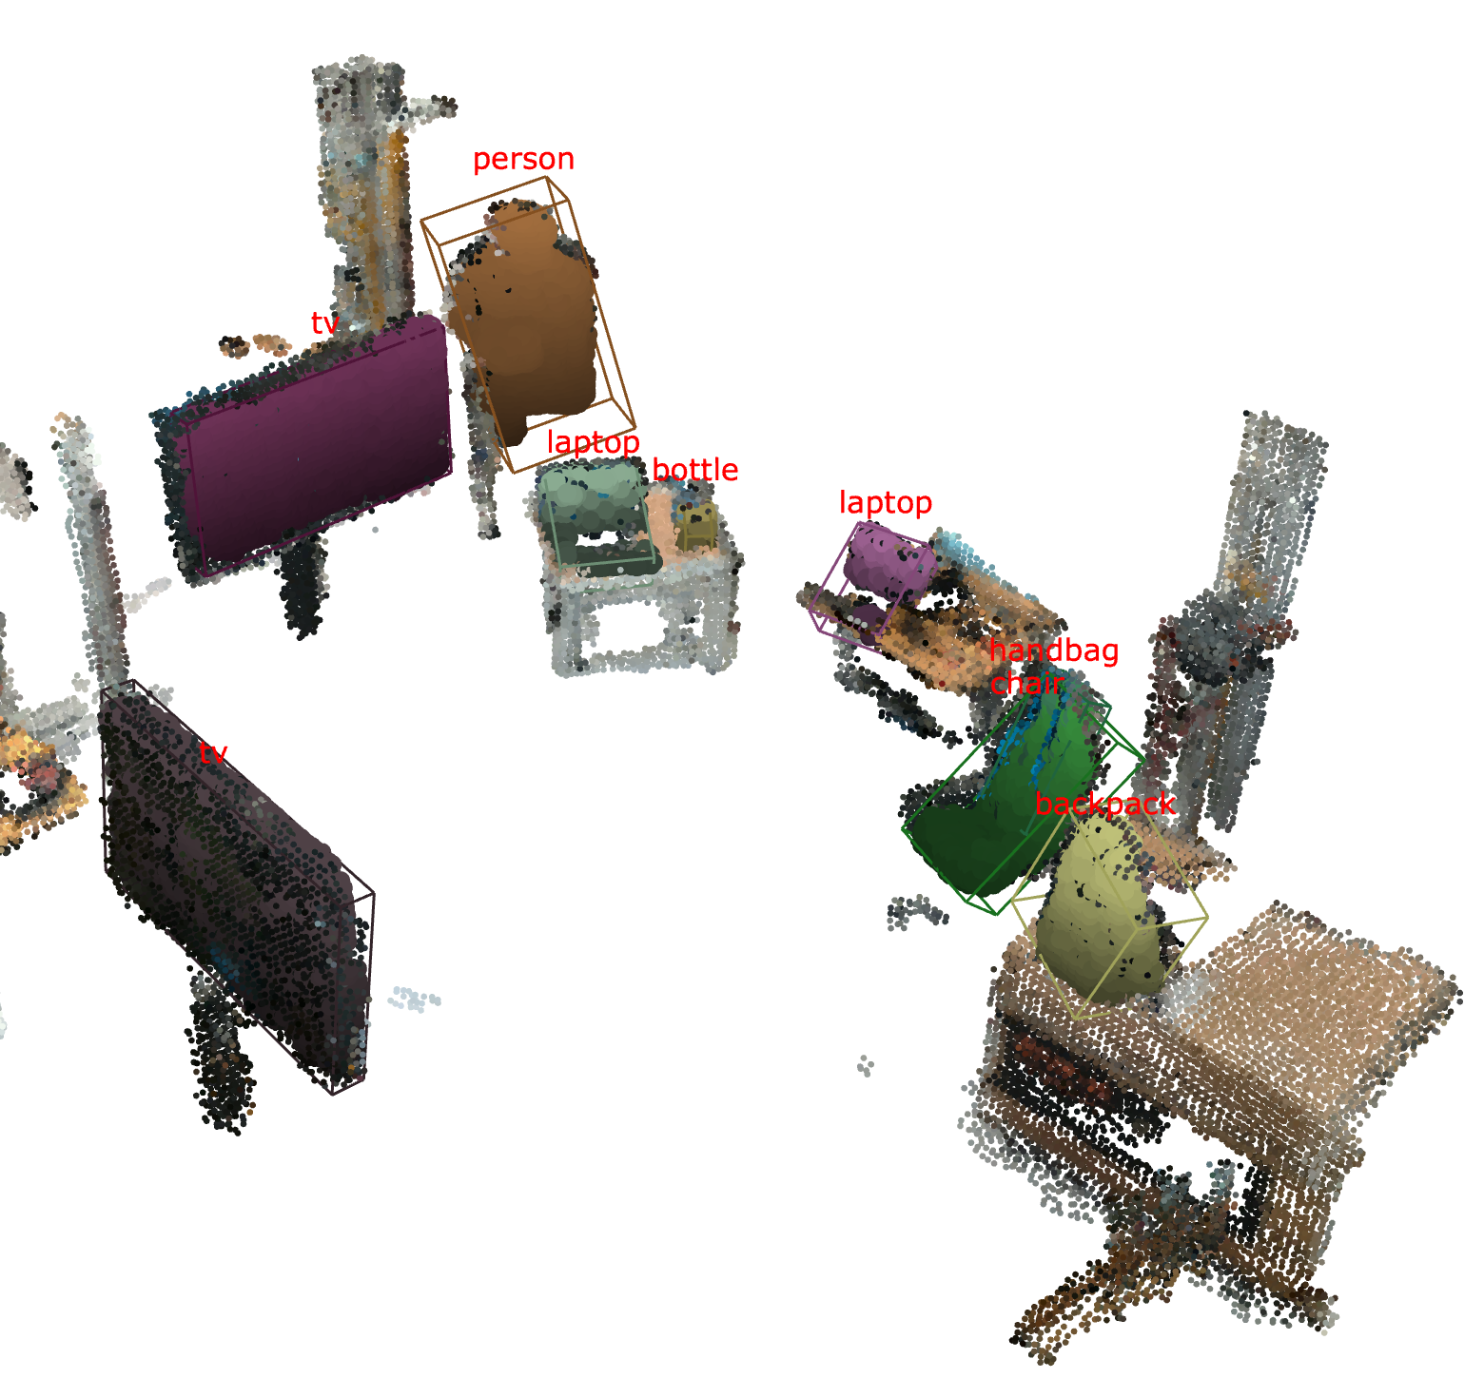
Objective
The objective is to design, deploy and test a 3D semantic mapping system that incrementally builds a 3D map with objects identities and volumes in real world scenarios.
Multimodal Data Fusion
Combines visual and spatial data for object representation.
Noise Reduction
Implements techniques to handle depth noise.
Object Re-identification
Uses KD-Trees to avoid redundancy and re-identify objects.

Slide 4
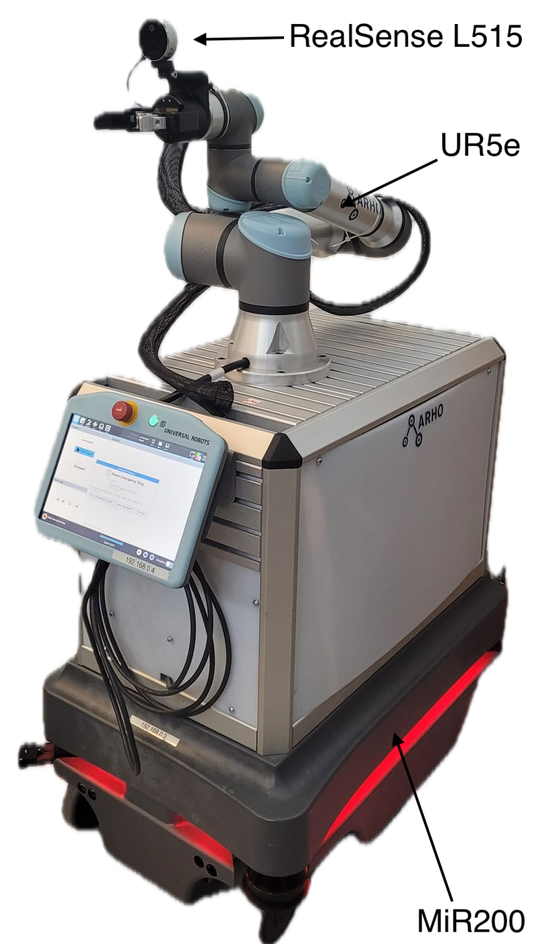




Heron Robot
High precision positioning system
Pre-built autonomous navigation stack
RGB-D Camera for 3D perception
Robotic Operative System 1 (ROS1)
Powerfull Computational Resources

Slide 5
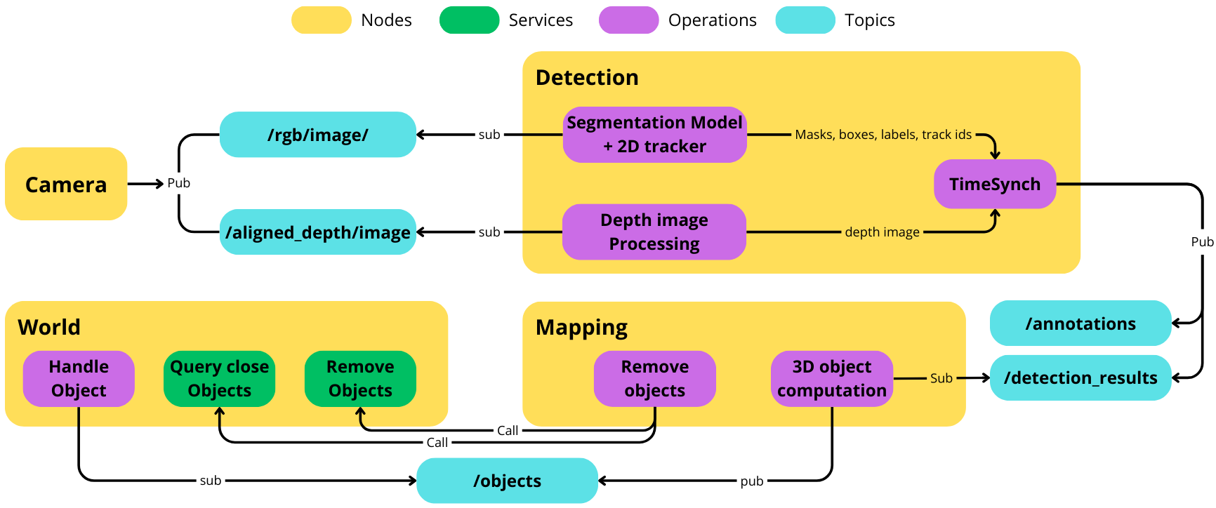
System architecure Overview

Slide 6
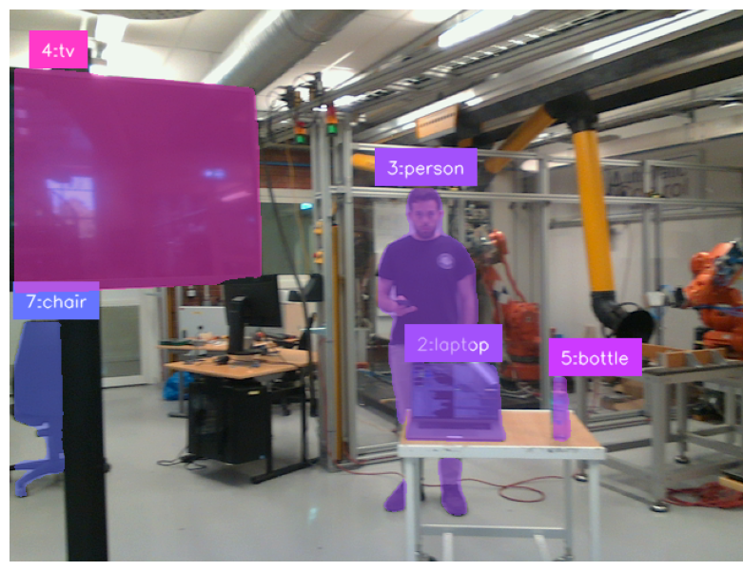
Instance Segmentation and Tracking
YOLOv8
Performs object instance segmentation with high detection accuracy, ensuring real time efficiency.
ByteTrack
Performs 2D Multi-Object Tracking (MOT) with unique IDs for each object, offering high speed and robustness against occlusions.

Slide 7
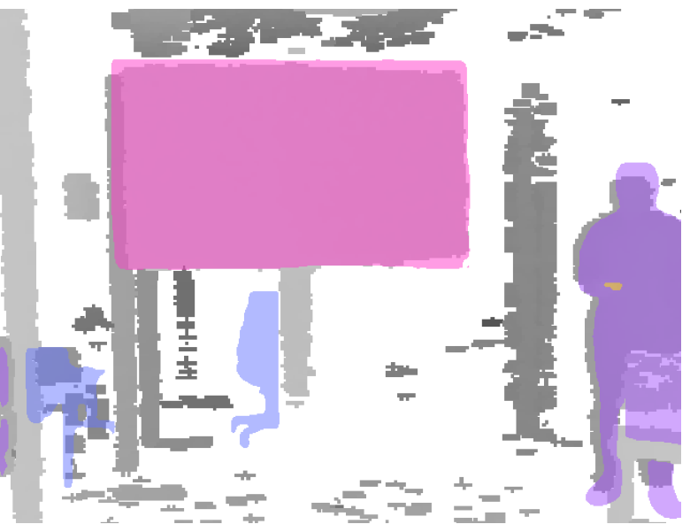
Object Projection
1
Apply Mask to Depth Image
Extracts object-specific depth information by applying segmentation mask
2
Project to Camera Coordinates
Transforms masked depth data into a 3D point cloud in the camera’s coordinate frame
Transform to World Coordinates
Query ROS for the roto-translation matrix at time t to transform the object’s 3D points in the world frame. Ensuring spatial consistency between objects
3

Slide 8
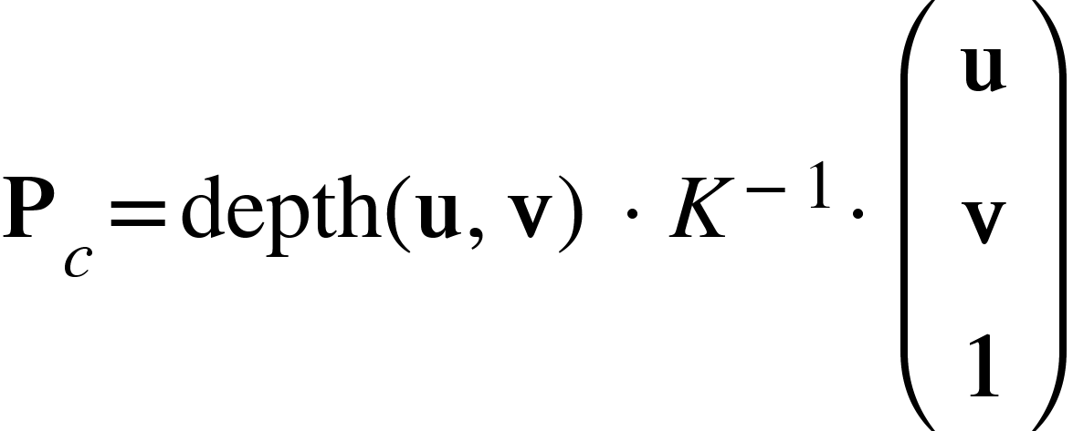
Object Projection
1
Apply Mask to Depth Image
Extracts object-specific depth information by applying segmentation mask
2
Project to Camera Coordinates
Transforms masked depth data into a 3D point cloud in the camera’s coordinate frame
Transform to World Coordinates
Query ROS for the roto-translation matrix at time t to transform the object’s 3D points in the world frame. Ensuring spatial consistency between objects
3

Slide 9

Object Projection
1
Apply Mask to Depth Image
Extracts object-specific depth information by applying segmentation mask
2
Project to Camera Coordinates
Transforms masked depth data into a 3D point cloud in the camera’s coordinate frame
Transform to World Coordinates
Query ROS for the roto-translation matrix at time t to transform the object’s 3D points in the world frame. Ensuring spatial consistency between objects
3

Slide 10
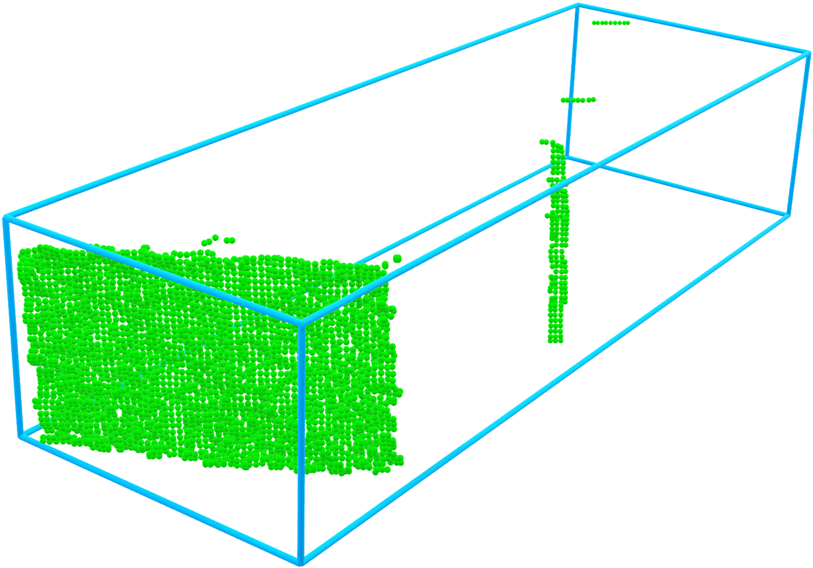
Point Cloud Preprocessing
Voxel Down Sampling
Voxel down sampling reduces point cloud density by retaining only one point per voxel, optimizing memory and enabling faster processing without losing essential structural details.
1
Noise Removal
Statistical outlier removal filters isolated points, while radius outlier removal targets sparse regions, improving point cloud quality.
2
Projected Point Cloud

Slide 11
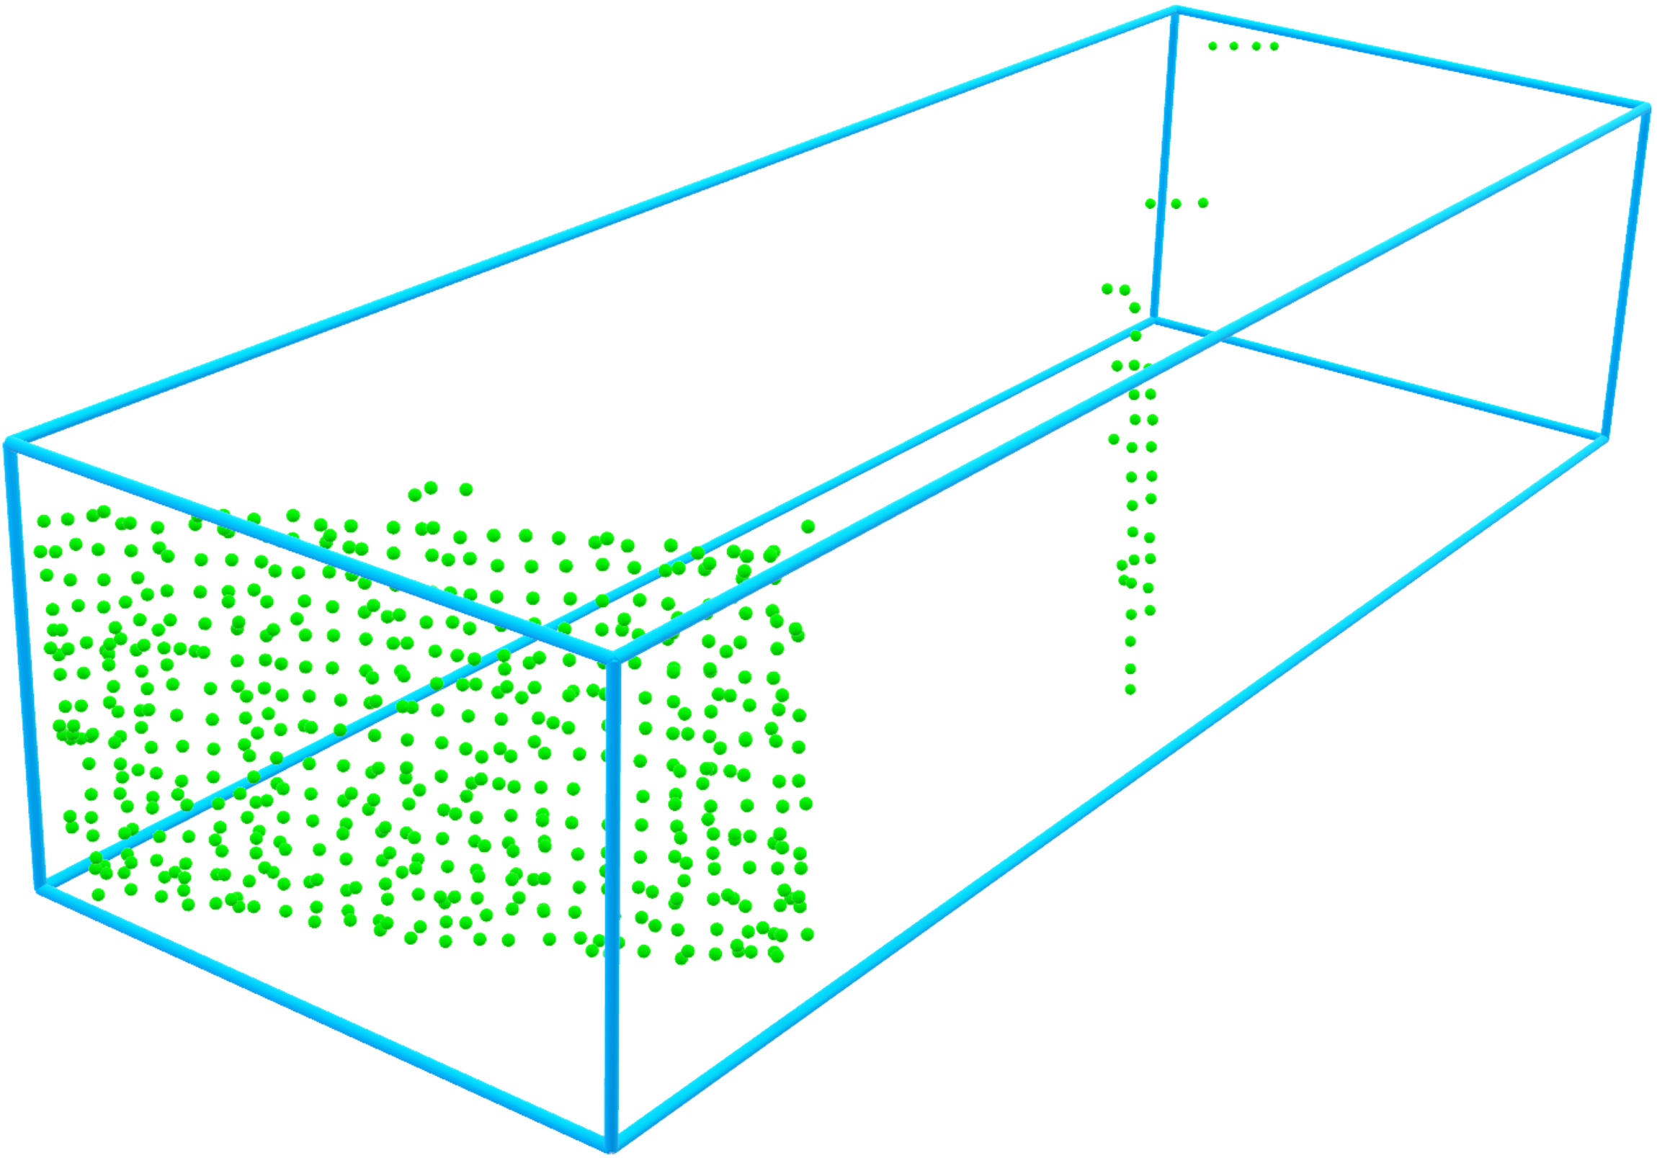
Point Cloud Preprocessing
Voxel Down Sampling
Voxel down sampling reduces point cloud density by retaining only one point per voxel, optimizing memory and enabling faster processing without losing essential structural details.
1
Noise Removal
Statistical outlier removal filters isolated points, while radius outlier removal targets sparse regions, improving point cloud quality.
2
Down-sampled Point Cloud

Slide 12
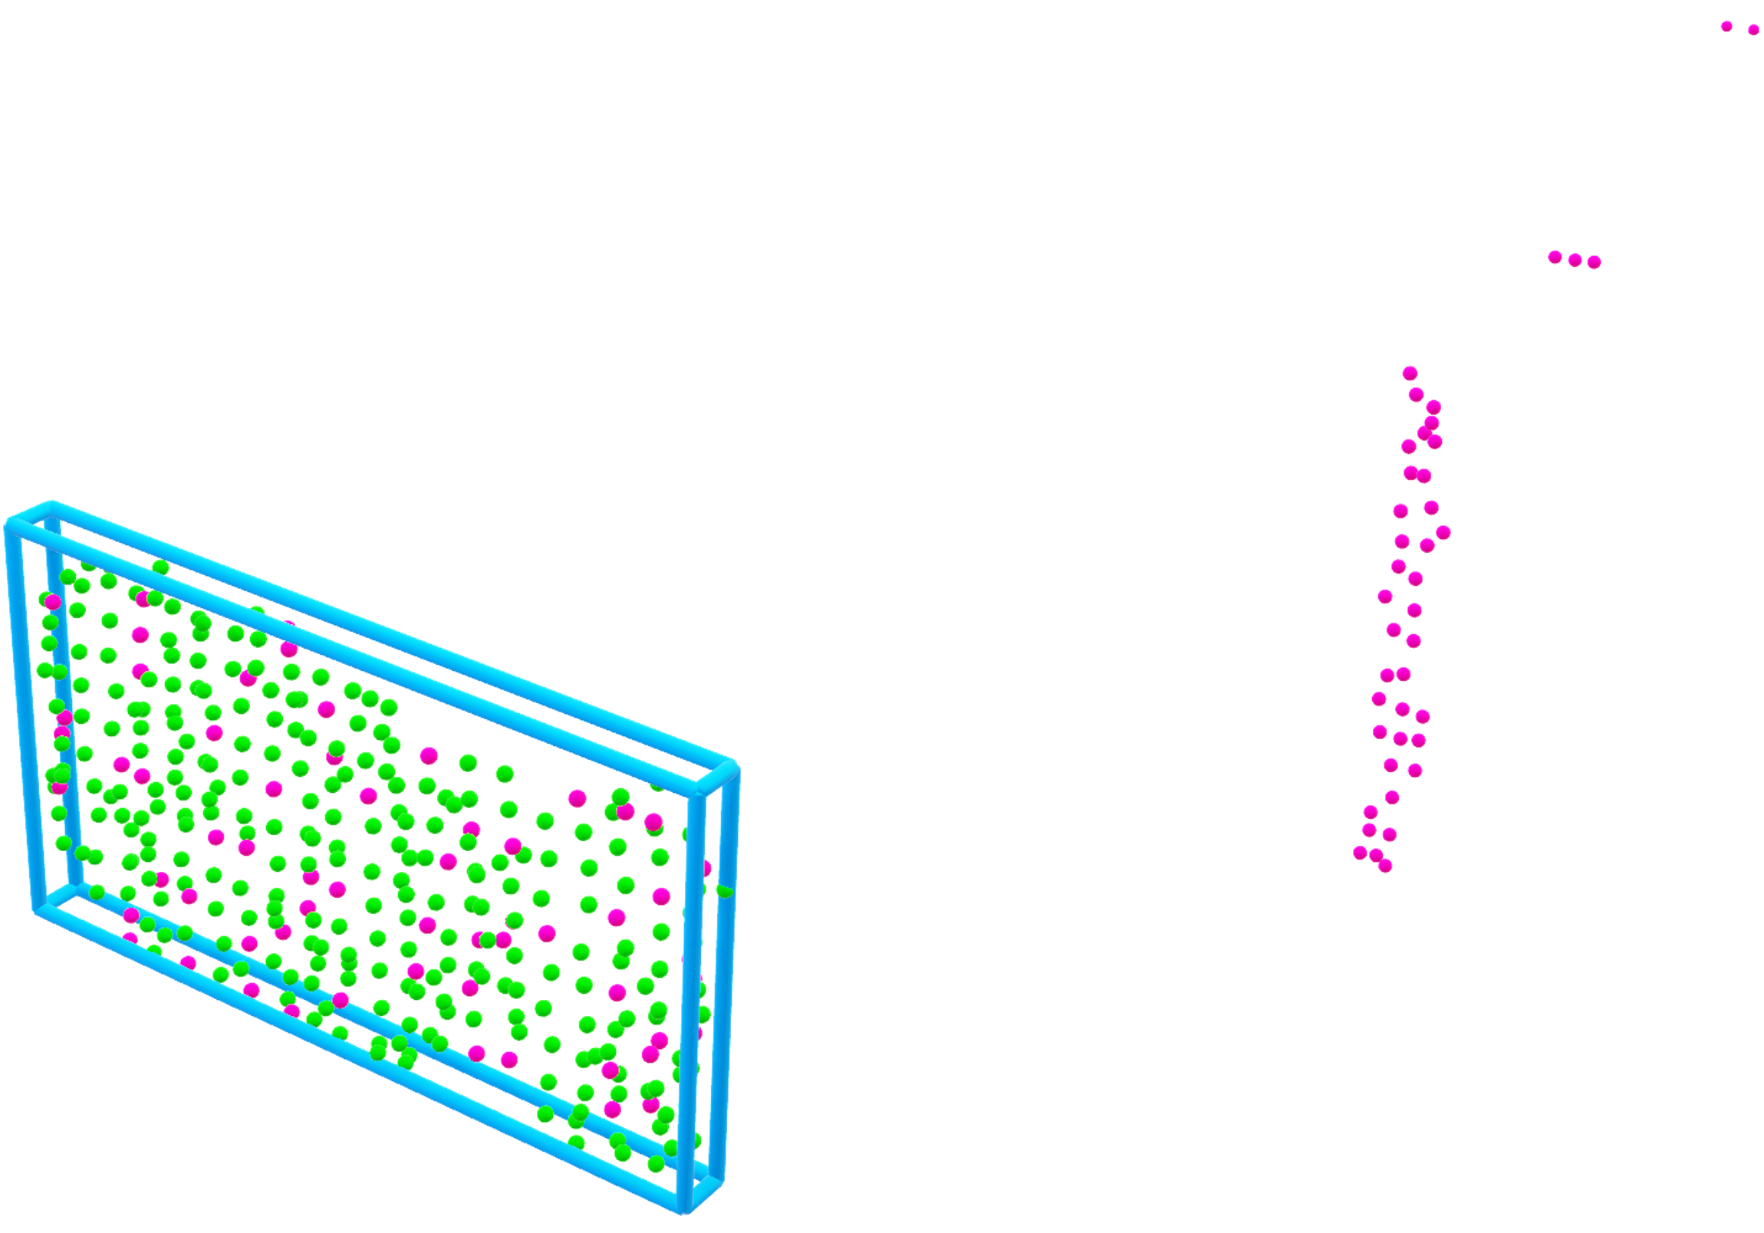
Point Cloud Preprocessing
Voxel Down Sampling
Voxel down sampling reduces point cloud density by retaining only one point per voxel, optimizing memory and enabling faster processing without losing essential structural details.
1
Noise Removal
Statistical outlier removal filters isolated points, while radius outlier removal targets sparse regions, improving point cloud quality.
2
Cleaned Point Cloud

Slide 13
3D Object Re-Identification
In 2D tracking, objects exiting and re-entering the field of view are assigned new IDs but we need to maintain a consistent identity for each object to ensure accurate tracking over time and avoid adding redundant objects.
New Detection
World Model
Close Objects
Query
Found
Not Found
Overlap?
Add new object
Merge Objects
No
Yes

Slide 14
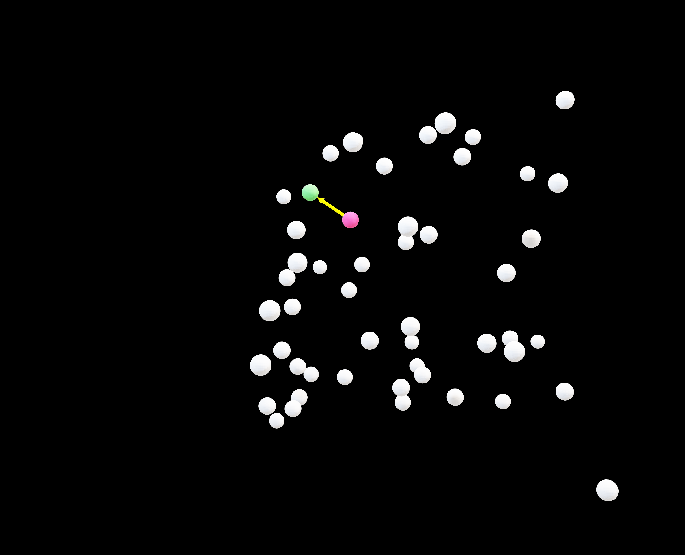
World Model – KD-Trees
Efficient Spatial Organization
Organizes object centroids hierarchically, based on their coordinates in space.
Rapid Spatial Queries
Enables fast nearest-neighbour searches, essential for locating nearby objects.

Slide 15
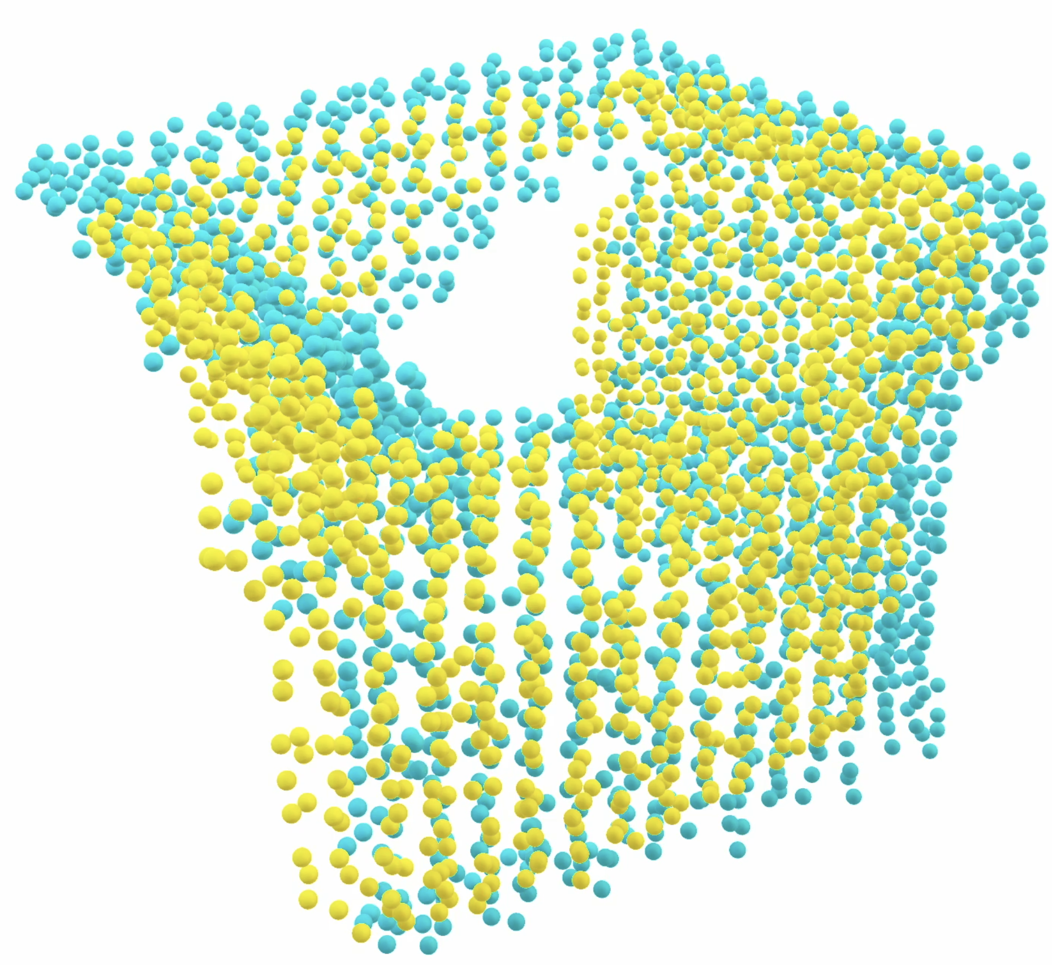
Point Cloud Overlap
Create 3D Occupancy Grid
Create for each point cloud a 3D occupancy grid. This standardizes the point cloud resolution and enables direct comparison between different point clouds
Compute Intersection
Identify intersecting regions between the grids, preparing for similarity calculation.
Compute Dice Coefficient
Calculate the Dice Coefficient to quantify overlap. If it exceeds a threshold, the clouds are considered to represent the same object.
Stored object
New detection

Slide 16
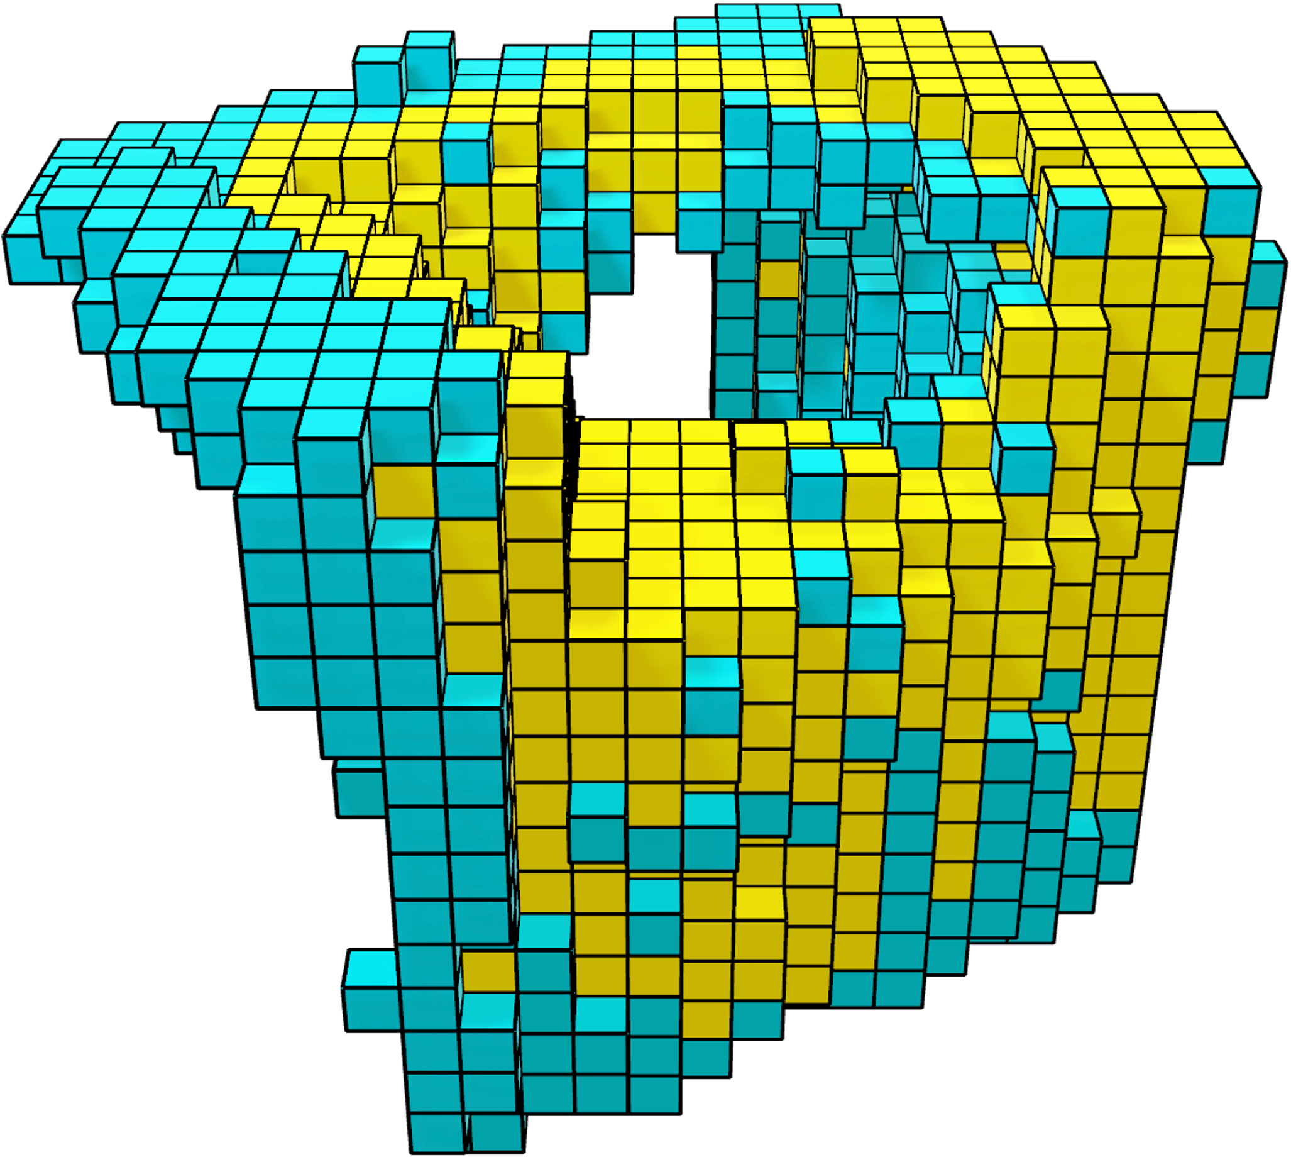
Point Cloud Overlap
Create 3D Occupancy Grid
Create for each point cloud a 3D occupancy grid. This standardizes the point cloud resolution and enables direct comparison between different point clouds
Compute Intersection
Identify intersecting regions between the grids, preparing for similarity calculation.
Compute Dice Coefficient
Calculate the Dice Coefficient to quantify overlap. If it exceeds a threshold, the clouds are considered to represent the same object.
Stored object
New detection

Slide 17
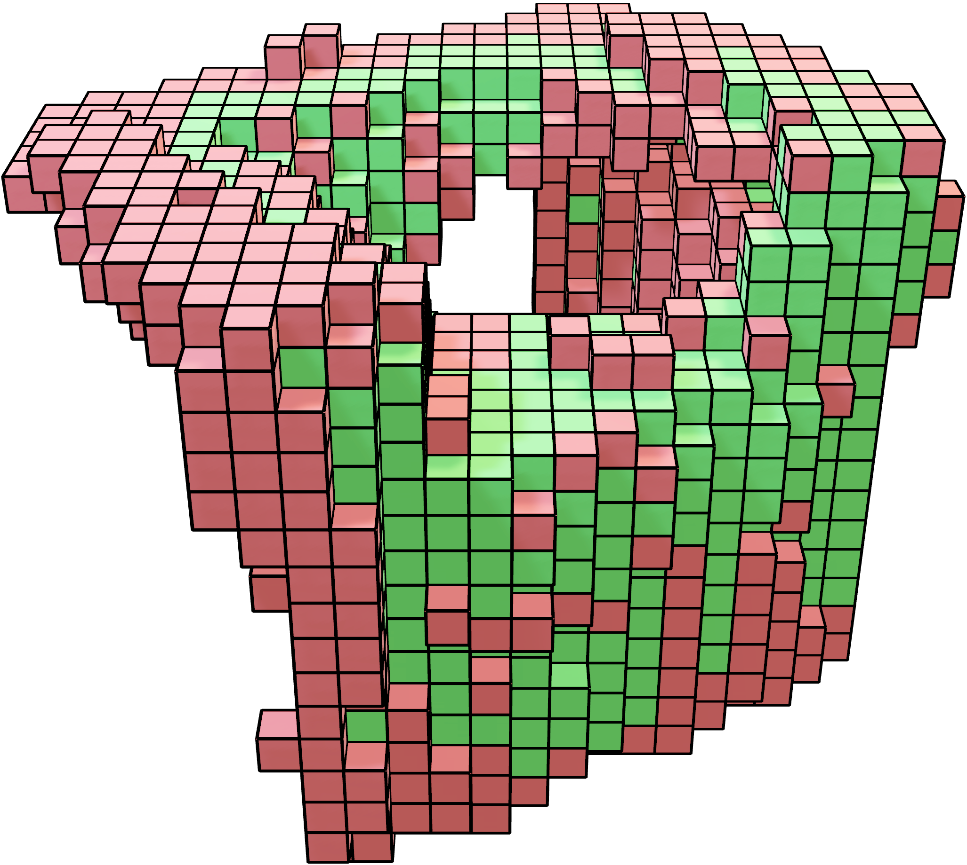
Point Cloud Overlap
Create 3D Occupancy Grid
Create for each point cloud a 3D occupancy grid. This standardizes the point cloud resolution and enables direct comparison between different point clouds
Compute Intersection
Identify intersecting regions between the grids, preparing for similarity calculation.
Compute Dice Coefficient
Calculate the Dice Coefficient to quantify overlap. If it exceeds a threshold, the clouds are considered to represent the same object.
Difference
Intersection

Slide 18
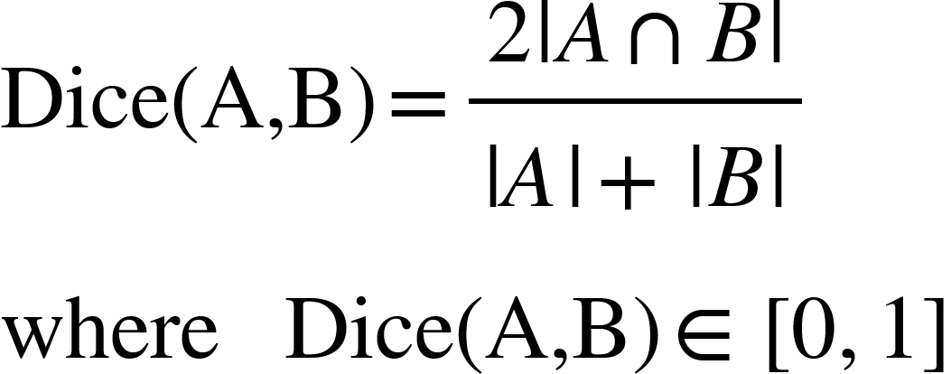
Point Cloud Overlap
Create 3D Occupancy Grid
Create for each point cloud a 3D occupancy grid. This standardizes the point cloud resolution and enables direct comparison between different point clouds
Compute Intersection
Identify intersecting regions between the grids, preparing for similarity calculation.
Compute Dice Coefficient
Calculate the Dice Coefficient to quantify overlap. If it exceeds a threshold, the clouds are considered to represent the same object.

Slide 19
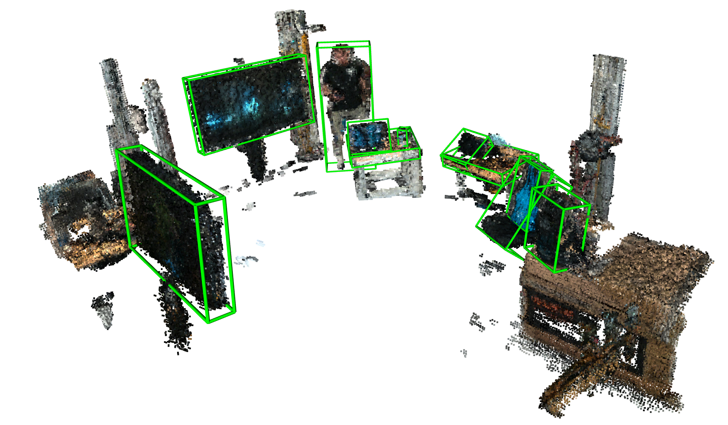
Data Collection and Annotation
Collection Method
Manual Navigation of Heron Robot in 7 different Environments with RTAB-MAP used for environment reconstruction
Data Annotation
The final reconstructed environment undergo labelling and bounding boxes annotation with LabelCloud
Dataset Overview
101 ground truth objects across 13 categories

Slide 20
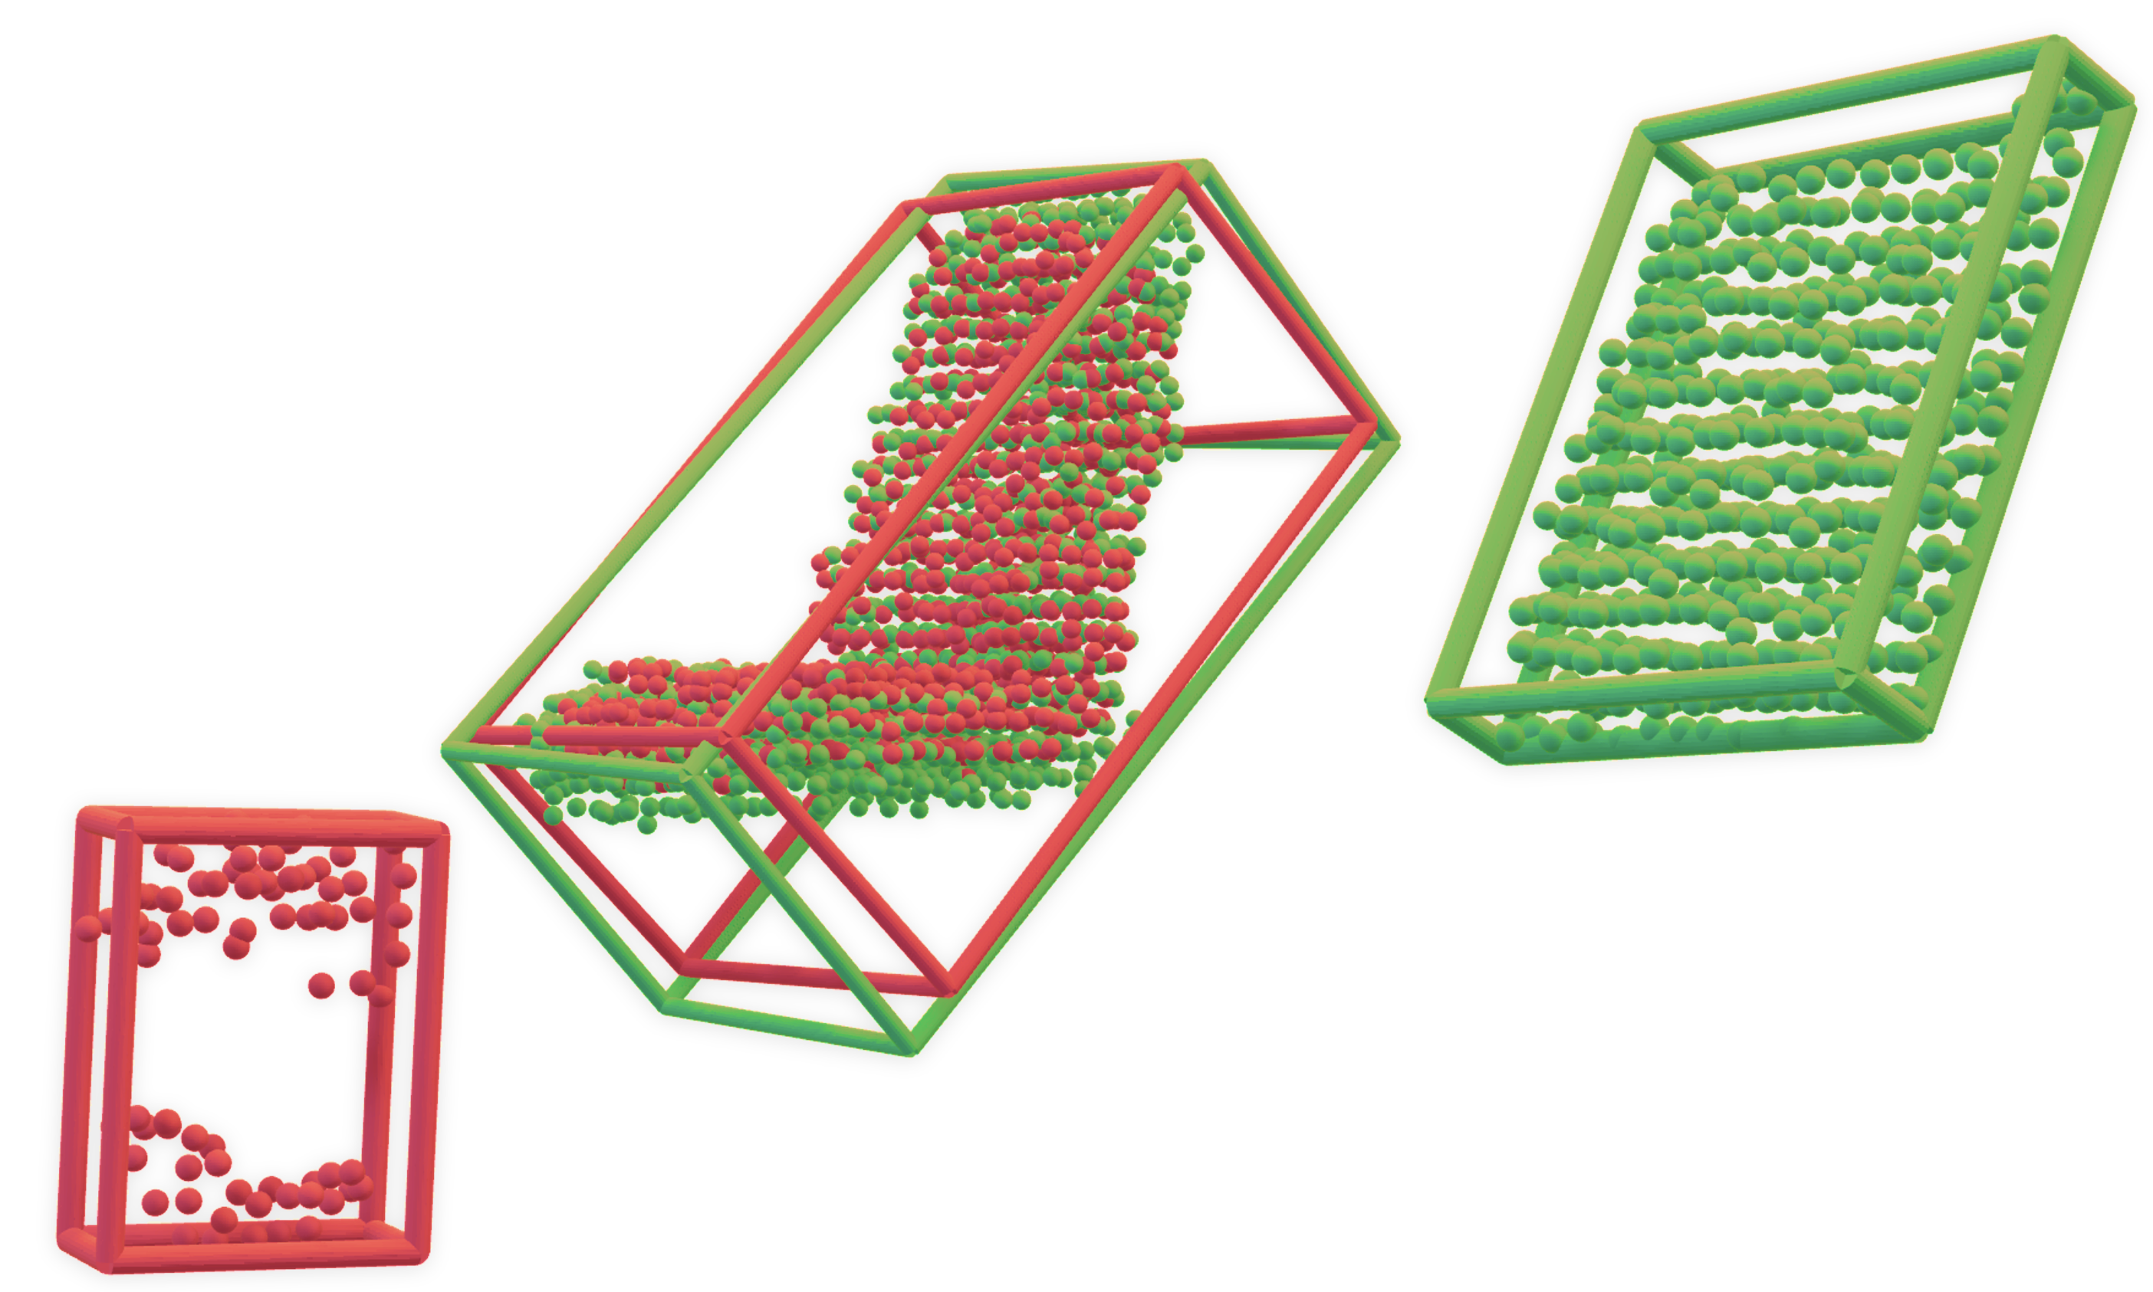
Evaluation Method
Match Ground Truth and Predicted Objects
Using a minimum overlap threshold, we extract sets of matching pairs, missed ground truths and phantom predictions
Matching pairs
Compute TP, FP, FN
From these sets compute True Positives (TP), False Positives (FP) and False Negatives (FN) for each class
Metrics
Mean Average Precision (mAP)
Macro averaged Precision
Macro Averaged Recall
Macro Averaged F1-Score
Frames Per Second (FPS)
Missed Ground Truth
Phantom Prediction

Slide 21
Results – Time Analysis
System Performance Evaluation
Execution times measured across Detection, Mapping and World nodes.
Average object number for each frame | FPS
1 | 22.73
2 | 11.36
3 | 7.58
4 | 5.68
5 | 4.55
Asynchronous Processing
Each node runs on separate threads, enabling parallel processing.
FPS Bottleneck:
Since Detection and Mapping nodes exceed 30FPS, only the World node affects the overall frame rate.
The /objects topic uses a queue size of 5 to retain only the most recent detections, preventing backlog buildup.

Slide 22
Results – Performance Metrics
Metrics evaluated at different overlap thresholds to assess performance across varying levels of spatial alignment.
1
2
High results with low thresholds indicates good detection and localization performances
Performance decreases as overlap thresholds increase, indicating challenges in object volume reconstruction.
3

Slide 23
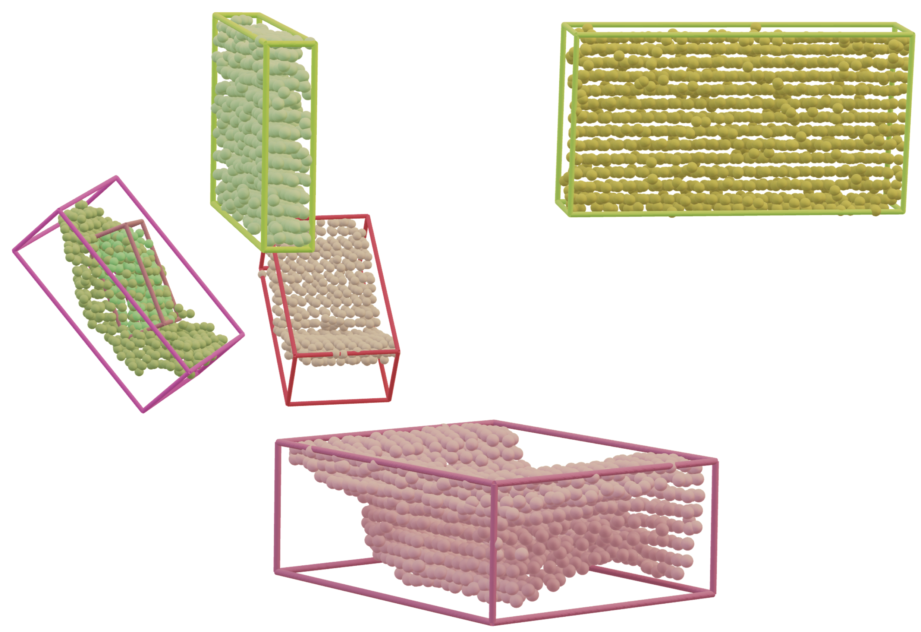
Conclusions
Key Contributions
The system enables 3D semantic mapping leveraging multimodal data, addressing object detection, re-identification, and noise removal challenges.
Achievements
The system achieves 80% mAP at a 0.4 minimum overlap threshold, maintaining an average processing speed of 11 FPS in the tested environments.
Future Directions
Enhance performance in dynamic environments, improve system efficiency, and experiment with different depth sensors.

Slide 24
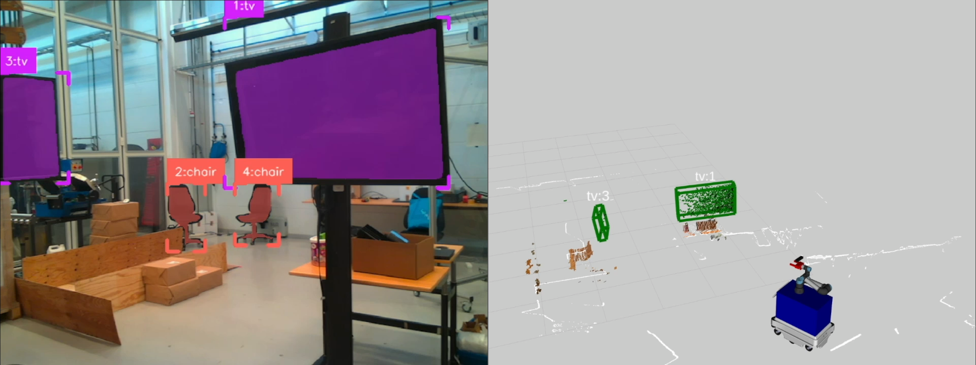
Thank You!

